Slide 1
Sector Growth vs. Company Growth (Replace with So What)
Market Trends Analysis | By Sector | National | Year over Year
Volume of sales in category
87.7 | 96.6 | 97.7
Value of sales in category
1,936.2 | 2,145.5 | 2,212.5
DATA SOURCE: Trade Panel/Retailer Data | Ending Dec 2022

Slide 2
Sector Growth vs. Company Growth (Replace with So What)
Concentration/Market position analysis by manufacturer | Confectionary | National
Volume of sales in category (%)
100% = | 87.7 | 96.6 | 97.7
Value of sales in category (%)
100% = | 1,936.2 | 2,145.5 | 2,212.5
DATA SOURCE: Trade Panel/Retailer Data | Ending Dec 2022

Slide 3
Market growth contributors (Replace with So What)
Market growth contributors | By Sectors | Confectionary | National | P12M | Index vs YA Value Sales DYA: 3
WOB%
Contribution to Growth/Decline
Value Sales (‘000’000) | 562.7 $ | 556.6 $ | 504.3 $ | 339.9 $ | 249.0 $
IYA | 100 | 106 | 97 | 104 | 118
DATA SOURCE: Trade Panel/Retailer Data | Ending Dec 2022
<90 Ix | <98 Ix |  | >102 Ix | >110 Ix

Slide 4
Sectors Value Sales & Avg Price Per Kg (Replace with So What)
Sectors Value Sales & Avg Price Per Kg | National | P12M
IYA
Avg Price/Kg
Value Sales
Growth Contribution
Sector WoB | 25% | 25% | 23% | 15% | 11% | 11% | 11% | 11% | 11% | 11% | 11% | 11% | 11% | 11% | 11% | 11% | 11% | 11% | 11% | 11% | 11% | 11%
Sector Avg Price Index | 122
Hersheys`s Share | 2% |  |  | 1%
DATA SOURCE: Trade Panel/Retailer Data | Ending Dec 2022
<-0.2% | -0.2% < x < 0.2% | >0.2%

Slide 5
Share and Growth by Manufacturer/Brands (Replace with So What)
Share and Growth By Manufacturer/Brands | Total Category | National
Top Manufacturers | LY DYA (%) | P12M Value Share (%) | P12M DYA (%) | Avg Price /Kg
Cisarua Mountain Dairy |  |  |  | 449
Greenfields |  |  |  | 274
Ffi |  |  |  | 66
Nestle |  |  |  | 49
Indolakto |  |  |  | 37
Ultra Jaya |  |  |  | 19
So Good Food |  |  |  | 182
Cs2 Pola Sehat |  |  |  | 263
Diamond Cold Storages Ind |  |  |  | 121
Abc Kogen Dairy |  |  |  | 675
Top Brands | P12M Value Share (%) | P12M DYA (%) | Avg Price /Kg | Avg Price /Kg IYA
Cimory |  |  | 449 | 90%
Greenfields |  |  | 274 | 108%
Frisian Flag |  |  | 66 | 94%
Indomilk |  |  | 37 | 102%
Ultra |  |  | 19 | 96%
Real Good |  |  | 177 | 82%
Kin |  |  | 675 | 105%
Milo |  |  | 63 | 92%
Tango |  |  | 345 | 110%
Milk Life |  |  | 304 | 93%
DATA SOURCE: Trade Panel/Retailer Data | Ending Sep 2022
<90 Ix | <98 Ix |  | >102 Ix | >110 Ix

Slide 6
Segment Leadership Analysis (Replace with So What)
Share and Growth By Manufacturer | By Sector | National | P12M
Choc Share Bags | Value Share (%) | DYA (%) | Avg Price /Kg
Brand 1 |  | -0.2%
Brand 2 |  | 0.9%
Brand 3 |  | 0.2%
Brand 4 |  | -
Brand 5 |  | 0.2%
Brand 6 |  | 0.1%
Brand 7 |  | -
Brand 8 |  | -
Brand 9 |  | -
Brand 10 |  | -0.1%
DATA SOURCE: Trade Panel/Retailer Data | Ending Sep 2022
<-0.2% | -0.2% < x < 0.2% | >0.2%

Slide 7
Segment Leadership Analysis (Replace with So What)
Share and Growth By Manufacturer | By Sector | National | P12M
Choc Share Bags | Value Share (%) | DYA (%) | Avg Price /Kg
Brand 1 |  | -0.2%
Brand 2 |  | 0.9%
Brand 3 |  | 0.2%
Brand 4 |  | -
Brand 5 |  | 0.2%
Brand 6 |  | 0.1%
Brand 7 |  | -
Brand 8 |  | -
Brand 9 |  | -
Brand 10 |  | -0.1%
Gifting | Value Share (%) | DYA (%) | Avg Price /Kg
Brand 1 |  | -0.2%
Brand 2 |  | 0.9%
Brand 3 |  | 0.2%
Brand 4 |  | -
Brand 5 |  | 0.2%
Brand 6 |  | 0.1%
Brand 7 |  | -
Brand 8 |  | -
Brand 9 |  | -
Brand 10 |  | -0.1%
DATA SOURCE: Trade Panel/Retailer Data | Ending Sep 2022
<-0.2% | -0.2% < x < 0.2% | >0.2%

Slide 8
Segment Leadership Analysis (Replace with So What)
Share and Growth By Manufacturer | By Sector | National | P12M
Choc Bars | Value Share (%) | DYA (%) | Avg Price /Kg
Brand 1 |  | -0.2%
Brand 2 |  | 0.9%
Brand 3 |  | 0.2%
Brand 4 |  | -
Brand 5 |  | 0.2%
Brand 6 |  | 0.1%
Brand 7 |  | -
Brand 8 |  | -
Brand 9 |  | -
Brand 10 |  | -0.1%
Choc Bites | Value Share (%) | DYA (%) | Avg Price /Kg
Brand 1 |  | -0.2%
Brand 2 |  | 0.9%
Brand 3 |  | 0.2%
Brand 4 |  | -
Brand 5 |  | 0.2%
Brand 6 |  | 0.1%
Brand 7 |  | -
Brand 8 |  | -
Brand 9 |  | -
Brand 10 |  | -0.1%
Choc Block | Value Share (%) | DYA (%) | Avg Price /Kg
Brand 1 |  | -0.2%
Brand 2 |  | 0.9%
Brand 3 |  | 0.2%
Brand 4 |  | -
Brand 5 |  | 0.2%
Brand 6 |  | 0.1%
Brand 7 |  | -
Brand 8 |  | -
Brand 9 |  | -
Brand 10 |  | -0.1%
DATA SOURCE: Trade Panel/Retailer Data | Ending Sep 2022
<-0.2% | -0.2% < x < 0.2% | >0.2%

Slide 9
Category Trends (Replace with So What)
Value Sales Vs. Avg Price Trend | Confectionary | Category Trends | National
DATA SOURCE: Trade Panel/Retailer Data | Ending Sep 2022

Slide 10
Share Evolution index analysis (Replace with So What)
Share Evolution index analysis | By Brands | Choc Bars | Convenience | Past 3 Years
Change in average Price/Kg
Change in average Share
DATA SOURCE: Trade Panel/Retailer Data | Ending Dec 2022

Slide 11
Category Overview (Replace with So What)
Sales trend on Value vs. Volume vs. Price | Total Confectionery | National | P12M
 | Category | % Change YA | Price IYA | Manufacturer | % Change YA | Price IYA | Pricing impact on growth -2pts
Value Sales (Kr M) | 2,212 | 3% | 102% | 14.7 | 41% | 99%
Volume Sales (kgM) | 98 | 1% |  | 0.5 | 43%
Value Sales (Kr M)
DATA SOURCE: | Trade Panel/Retailer Data | Ending May 2023

Slide 12
Category Evolution Analysis (Replace with So What)
Sales and Growth By Sector | National | P12M
 | Total |  |  |  |  | Nomad
 | Value Sales (M) | Value Sales IYA | Volume IYA | Avg Price /Vol | Avg Price /Vol IYA | Value Sales (M) | Value Sales IYA | Volume IYA | Avg Price /Vol | Avg Price /Vol IYA
Frozen Fish |  | 128 | 128 | €9.90 | 128 |  | 128 | 128 | €9.90 | 128
Fish: Seafood |  | 101 | 101 | €9.90 | 101 |  | 101 | 101 | €9.90 | 101
Fish: Fillets |  | 184 | 184 | €9.90 | 184 |  | 184 | 184 | €9.90 | 184
Fish: Fish Fingers |  | 97 | 97 | €9.90 | 97 |  | 97 | 97 | €9.90 | 97
Fish: Coated Fish |  | 120 | 120 | €9.90 | 120 |  | 120 | 120 | €9.90 | 120
Fish: Fish Recipes |  | 112 | 112 | €9.90 | 112 |  | 112 | 112 | €9.90 | 112
DATA SOURCE: Trade Panel/Retailer Data | Ending Sep 2022
<90 Ix | <98 Ix |  | >102 Ix | >110 Ix

Slide 13
Share and Growth by Retailer/Channel (Replace with So What)
Share and Growth By Retailer | Total Category | P12M
 | Total Category | Total Category
 | Value Sales (M) | WoB (%) | DYA (%) | Avg Price /Kg | Avg Price /Kg IYA
Total |  |  |  | 449 | 90
Retailer 1 |  |  |  | 274 | 108
Retailer 2 |  |  |  | 66 | 94
Retailer 3 |  |  |  | 49 | 102
Retailer 4 |  |  |  | 37 | 96
Retailer 5 |  |  |  | 19 | 82
Retailer 6 |  |  |  | 182 | 105
Retailer 7 |  |  |  | 263 | 92
Retailer 8 |  |  |  | 121 | 110
Retailer 9 |  |  |  | 675 | 93
Client | Client
Value Sales (M) | WoB (%) | DYA (%) | Avg Price /Kg | Avg Price /Kg IYA
 |  |  | 449 | 90
 |  |  | 274 | 108
 |  |  | 66 | 94
 |  |  | 37 | 102
 |  |  | 19 | 96
 |  |  | 177 | 82
 |  |  | 675 | 105
 |  |  | 63 | 92
 |  |  | 345 | 110
 |  |  | 304 | 93
DATA SOURCE: Trade Panel/Retailer Data | Ending Sep 2022
<90 Ix | <98 Ix |  | >102 Ix | >110 Ix

Slide 14
Momentum Analysis (Replace with So What)
ERROR
P3M Share DYA (%)
1 | Traditional Trade/Ciucas
2 | Penny/Ciucas
3 | Penny/Ursus
4 | Profi Group/Ciucas
5 | Profi Group/Timisoreana
6 | Traditional Trade/Neumarkt
7 | Penny/Timisoreana
8 | Traditional Trade/Timisoreana
9 | Profi Group/Ursus
10 | Hyper Kaufland/Ursus
11 | Profi Group/Neumarkt
12 | Penny/Neumarkt
13 | Hyper Kaufland/Ciucas
14 | Traditional Trade/Ursus
15 | Hyper Kaufland/Heineken
16 | Hyper Kaufland/Timisoreana
17 | Traditional Trade/Bergenbier
18 | Profi Group/Heineken
19 | Penny/Heineken
20 | Hyper Kaufland/Neumarkt
21 | Profi Group/Tuborg
22 | Traditional Trade/Tuborg
23 | Hyper Kaufland/Becks
TURNAROUND
GROWTH
DECLINE
DECELERATION
P12M Share DYA (%)
DATA SOURCE: Trade Panel/Retailer Data | Ending Apr 2024
P3M Share DYA % and P12M Share DYA % < 0
P3M Share DYA % and P12M Share DYA % > 0

Slide 15
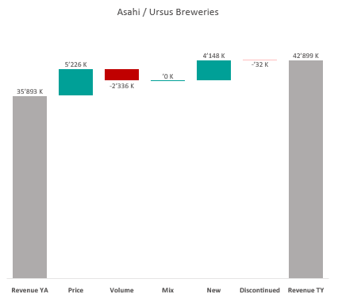

Revenue by Price vs. Volume vs. Mix analysis (Replace with So What)
Revenue by Price vs. Volume vs. Mix analysis | Heineken Romania vs. Asahi | Category | National | P12M
DATA SOURCE: Trade Panel/Retailer Data | Ending Apr 2024

Slide 16
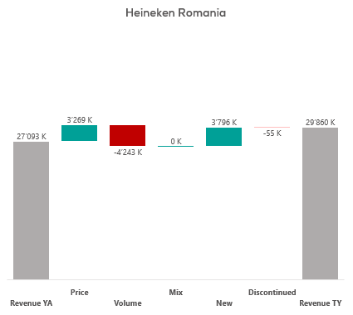
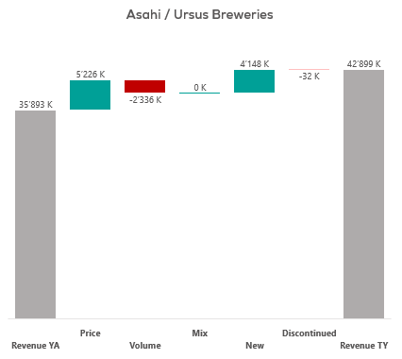
Revenue by Price vs. Volume vs. Mix analysis (Replace with So What)
Revenue by Price vs. Volume vs. Mix analysis | Heineken Romania vs. Asahi | Category | National | P12M
DATA SOURCE: Trade Panel/Retailer Data | Ending Apr 2024

Slide 17
Sectors Value Sales & Avg Price Per Kg (Replace with So What)
Sectors Value Sales & Avg Price Per Kg | National | P12M
IYA
Avg Price/Kg
Value Sales
Sector WoB | 25% | 25% | 23% | 15% | 11% | 11% | 11% | 11% | 11% | 11% | 11% | 11% | 11% | 11% | 11% | 11% | 11% | 11% | 11% | 11% | 11% | 11%
Sector Avg Price Index | 122
Hersheys`s Share | 2% |  |  | 1%
DATA SOURCE: Trade Panel/Retailer Data | Ending Dec 2022
<-0.2% | -0.2% < x < 0.2% | >0.2%

